Slide 1
After “a little” redaction…

Slide 2
What is bootstrapping?
Generally speaking, bootstrapping is the ability for a compiler written in a certain programming language to be able to compile itself.
The term stems from the saying "to pull oneself up by one's bootstraps“ which was in popular use during the 19th century as an example of an impossible task.
The reason for its usage in describing the boot process comes from the fact that if software is loaded onto a computer by other software already running on the computer, some must have been some mechanism that allows the initial software to be loaded onto the computer.

Slide 3
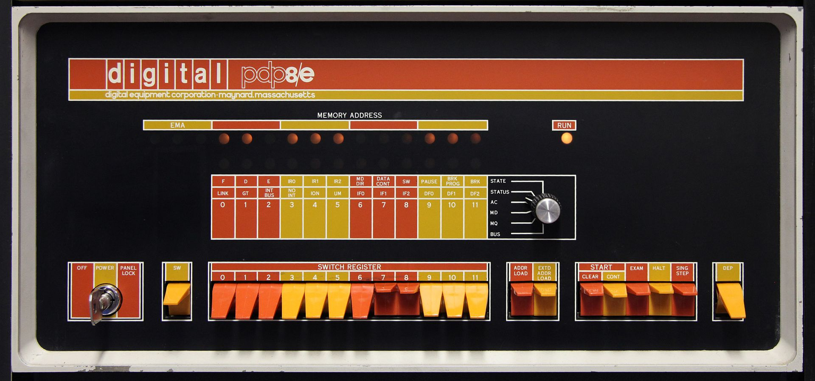
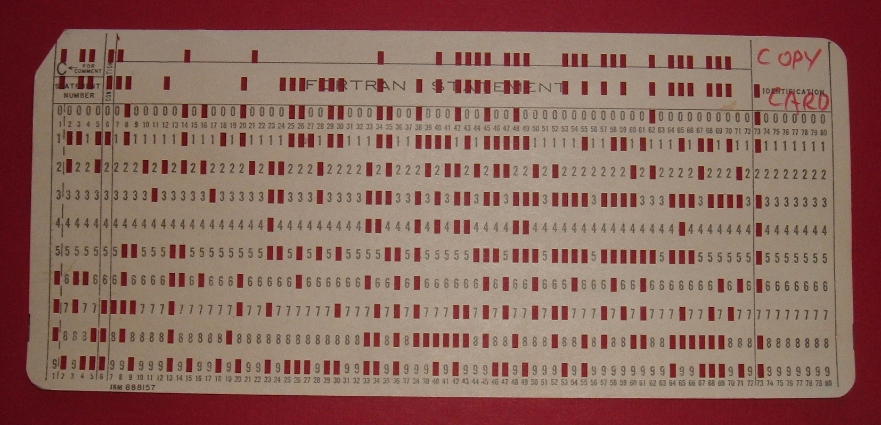
History of bootstrapping
Switches used to load the bootstrap program.
Before the introduction of integrated rom-based firmware, computers had to be booted through inputs medias such as punch cards or magnetic tapes which contained a bootstrap program for the computer and used switch panels on the device to load the program from a specified device into the core memory; a form of memory that is not erased after the device is turned off. From there the processor of the device would execute the program.
In addition to this, some devices had hardware loaders which would automatically load the program directly in the core memory at the push of a button.
Punch card used for bootstrap program.

Slide 4
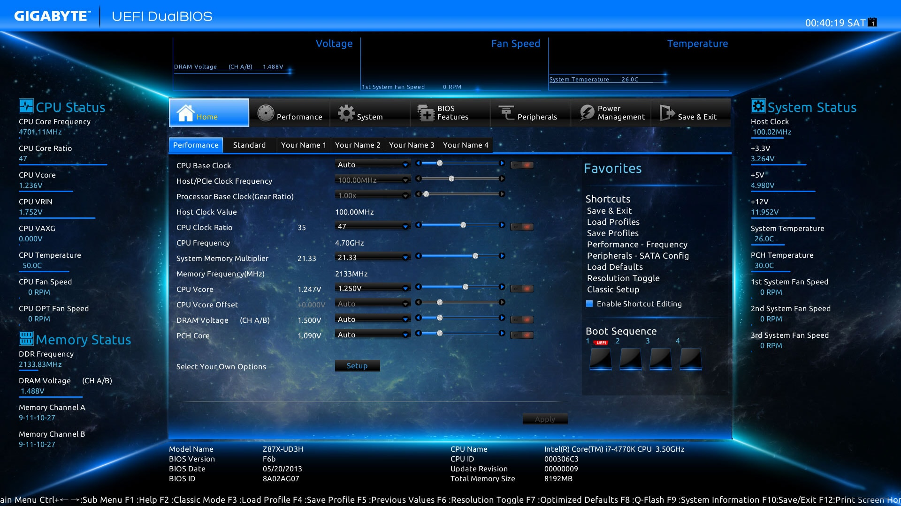
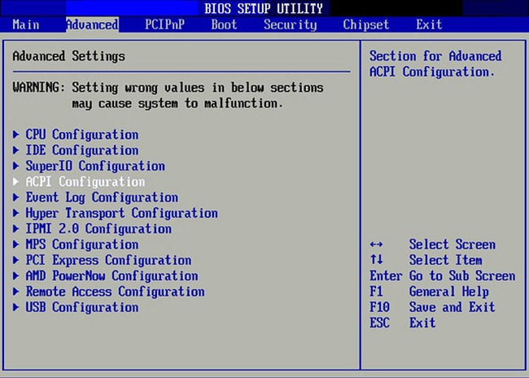
Future of booting(UEFI)
Modern UEFI Interface (GUI)
The Unified Extensible Firmware Interface (UEFI) is a software technology that prepares a computer to boot into an operating system after it is turned on and is being marketed as a replacement for the Basic Input Output System (BIOS).
Unlike BIOS, it is platform independent, meaning it isn’t locked into a specific Computer Architecture and could potentially be used on other types of hardware, like tablets. An application that mimics the traditional behaviour of BIOS can also be created to enable backward-compatibility. The maximum size of a Hard Drive also rises from about 2 terabytes under BIOS to 9.4 zettabytes in UEFI.
UEFI also has a “secure boot” feature which checks that the system boot loader has a digital signature authorized by a database contained in the firmware in order to make sure that the software used in booting is produced by the original manufacturer.
BIOS Interface

